Slide 1
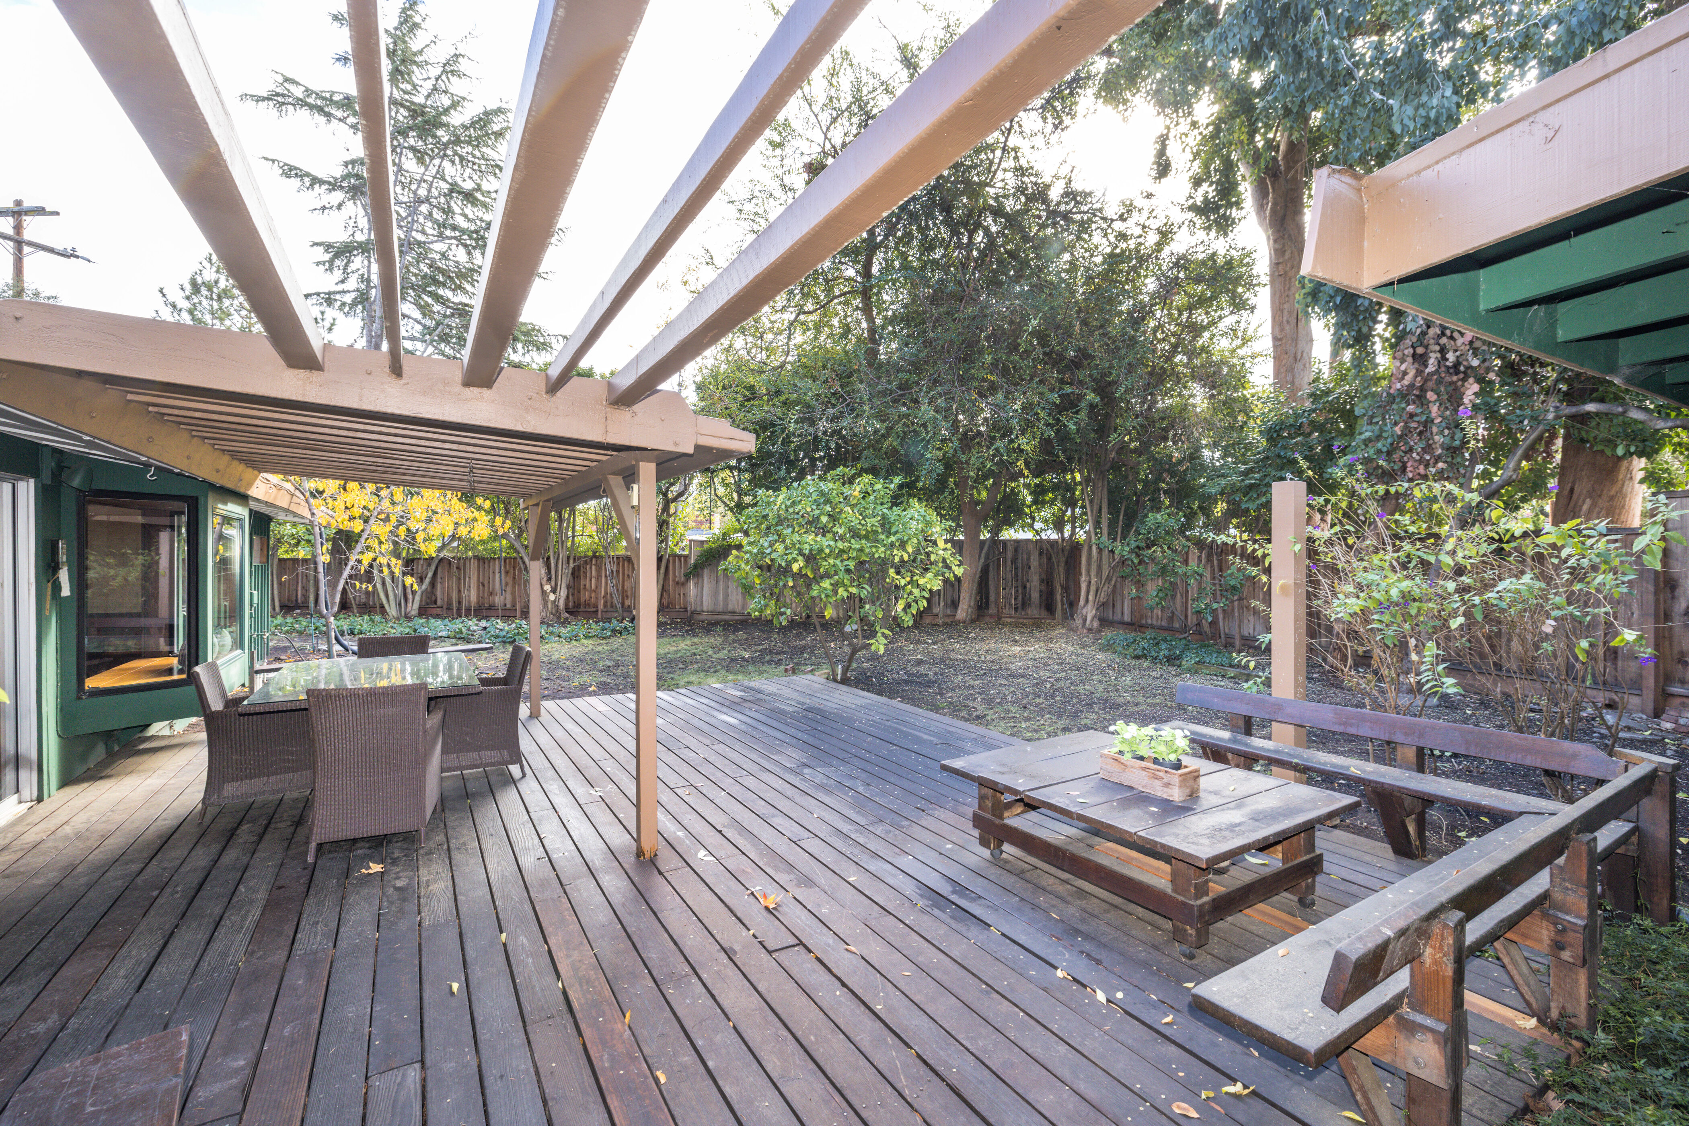
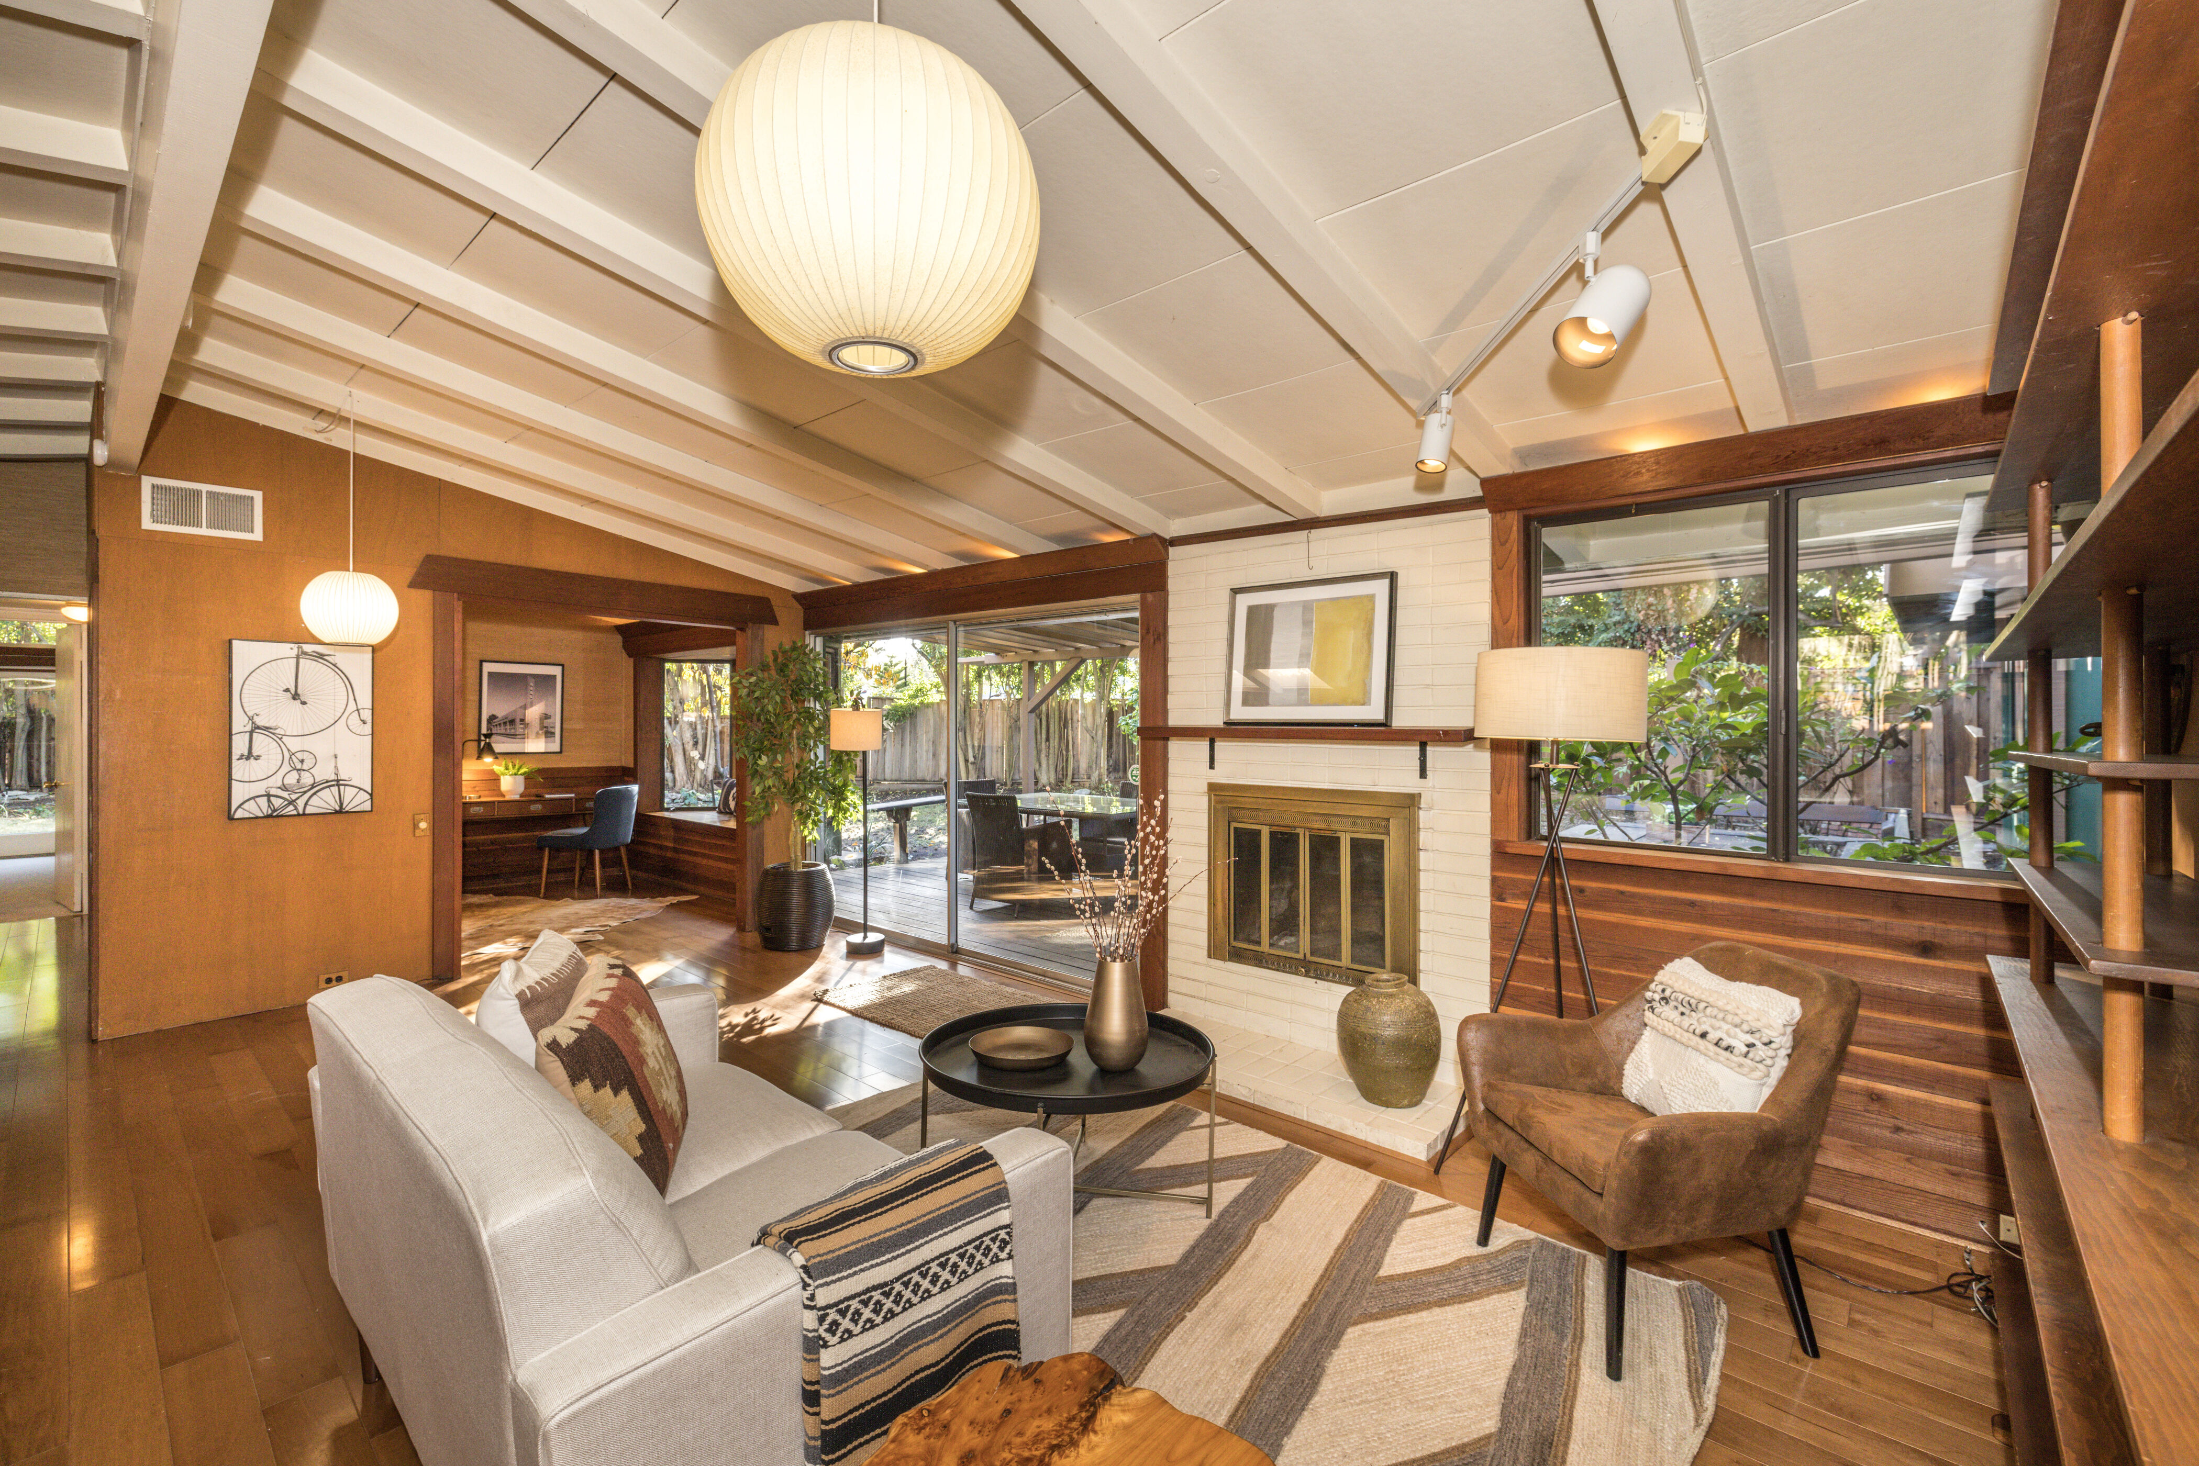
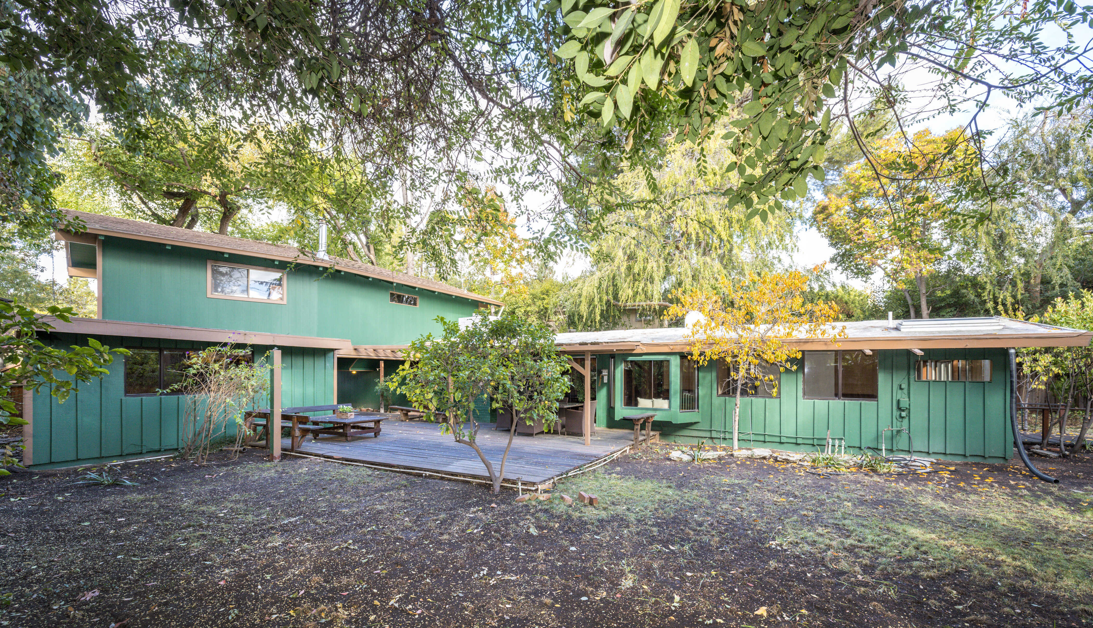
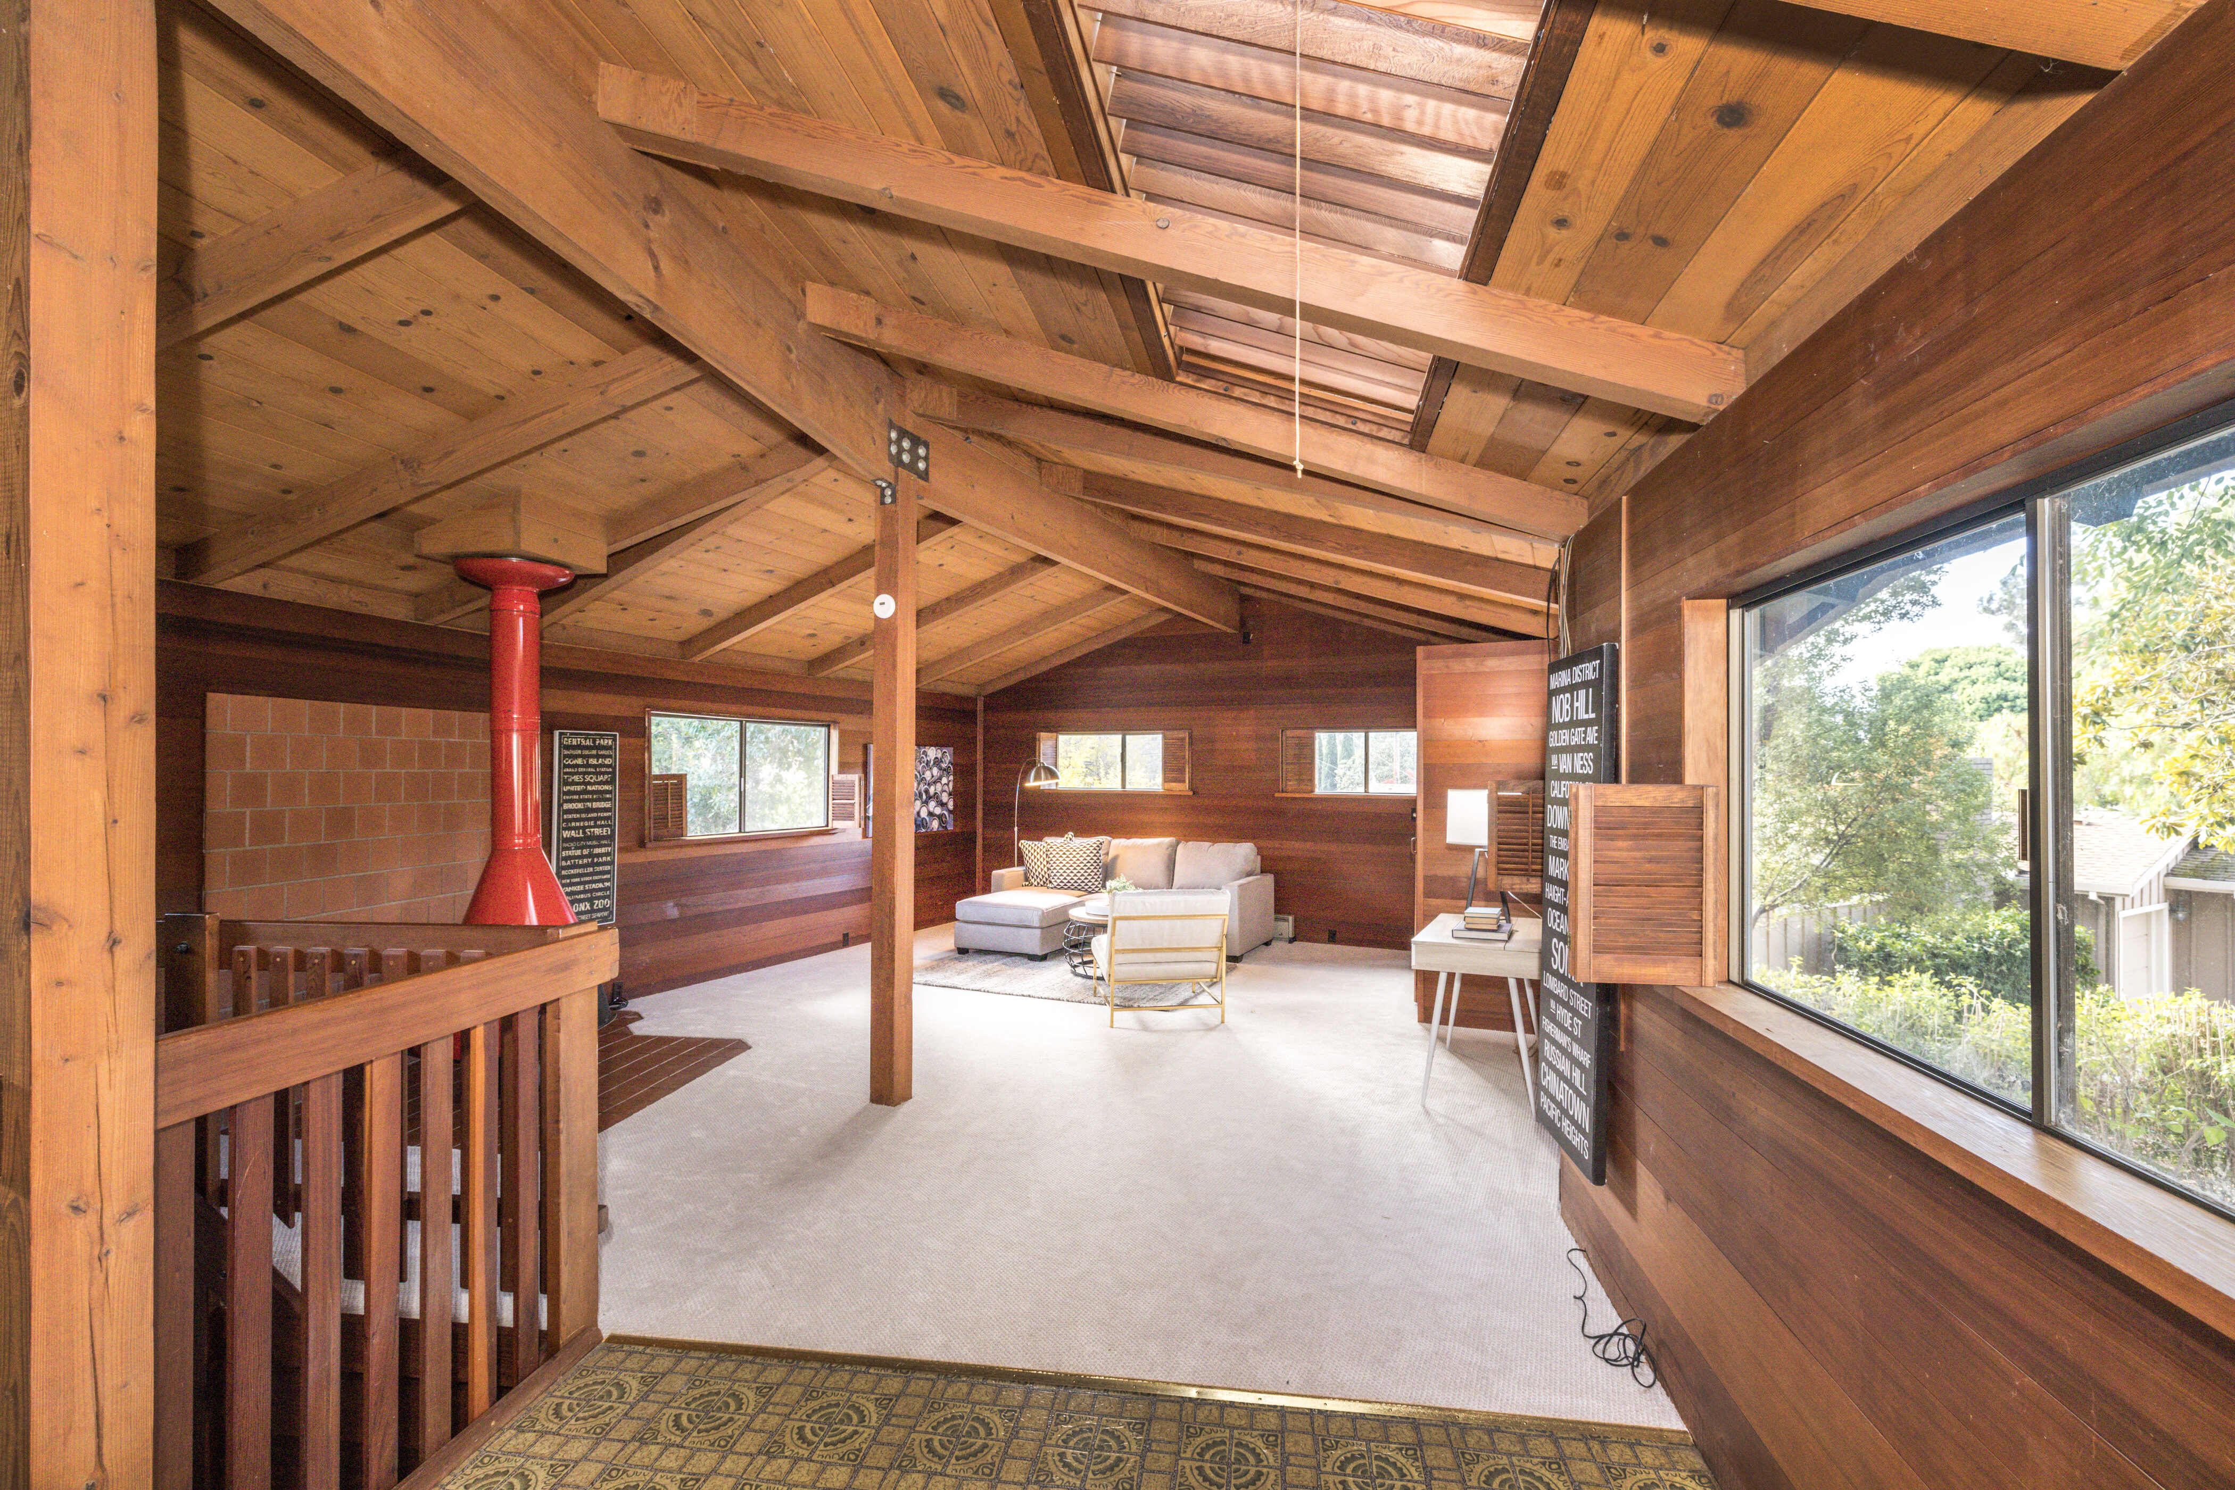
3029 Price Court, Palo Alto
Large Lot on a Wonderful Midtown Cul-De-Sac!
Spacious Home With a Highly Flexible Floor Plan Offering Abundant Possibilities!
3 bedrooms, 2 bathrooms:
private primary suite
easily configurable as a four, five or even as a six bedroom home
Spacious “great room” with walls of windows overlooking large, private backyard
Detached ”bonus” room
Enormous upstairs addition with vaulted, open beam ceilings
Extra large lot desirably located at the end of a quite Midtown cul-de-sac
Excellent Palo Alto schools
Home Size: 2,353 square feet (approx.)
Lot Size: 9,143 square feet (approx.)
Midtown Realty, Inc. • 2775 Middlefield Road • Phone: 650.321.1596 • www.midtownpaloalto.com
Listing Agent: Tim Foy
CalBRE# 00849721
Cell: 650.387.5078
tim@midtownpaloalto.com
OFFERED AT $3,500,000
Open Saturday & Sunday 1:30 PM to 4:30 PM

